Slide 1
WOA7014 ROBOTICS AND INTELLIGENT SYSTEMS
Mini Project 1: CarRacing-v0
Group Team members:
Mohamed Moussad Mohamed Ibrahim (17220121)
Shang Zhiyu (S2000785)

Slide 2
CONTENTS
01.
Problem Definition
02.
Environment and Simulation
03.
Proposed Approach
04.
Related Work
05.
Possible Experiments
06.
Some Initial Results

Slide 3
Problem Definition
This project aims to challenge the car racing problem in OpenAI Gym environment. The problem is very challenging because it requires computers (GPU) to finish the continuous control task by learning pixels of images. To tackle this challenging problem, we used three techniques including the Convolutional neural network layer, Echo state network (reservoir), and controller (optimization layer).
The car racing-v0 environment is a very simple problem such as a tracking car. Our goal is how to drive the car without moving outside the track. We use a Deep Neural Network to train and test the models to be able to drive in the lane.
Sensors with high processing speed make decisions faster than humans.

Slide 4
Environment and Simulation
Deep Neural Learning
Use imitation learning to train an agent to play the game Car Racing from OpenAI Gym. The model used to mimic the behavior of the expert was a convolutional neural network. Imitation learning is trying to replicate the expert.
In the beginning, the game plays manually with some statistics values to generate samples to train the neural networks and after that, we will try to test the car in the environment and get the average reward score. The agent was able to achieve the last reward of 595 over 15 episodes.
Parameters
Number of episodes
Batch size
Number of batches
Display step
Learning rate

Slide 5
Environment and Simulation
Control
It can control the car by two methods:
Increased break strength. The agent can drive faster and reduce the velocity before turns.
Implement logic that automatically cuts gas when turning.
There are data preprocessing using expert data to train the network
Layout Descriptions
Recolored the status bar with gray. This made the velocity indicator more visible
Recolored grass with a single shade of green
Recolored road with a single shade of gray
Recolored curbs with the same gray used on the road

Slide 6
Environment and Simulation
Agent’s function
OpenAI Gym environment uses pixel values as inputs for neural Convolutional Neural Network.
The input is (96X96X3) RGB image, and the image will convert into grayscale (96X96) size to simplify the state space.
The steps of the agent’s actions:
Add the current state to state history.
The first action will be to accelerate.
If the car is stuck for too long, the neural network is overwritten.
If the car is frozen, use a neural network to choose the next action.

Slide 7
Environment and Simulation
Neural network
It is written in Tensorflow, and it is inside my_neural_network folder
It works as a high-level API, analogous to Keras or PyTorch’s sequential.
We train the model longer because the validation accuracy was still steadily improving until the training accuracy reaches 69%.
Use CNN to train the agent well and improve autonomous drivers and tries to drive safely.
The agent uses a data set that is the most useful observations by humans with neural network algorithms in addition to the overwrite logic theory.

Slide 8
Environment and Simulation
Layers of neural network
The layers focus on (features extraction, echo state network, optimization) to run the model.
1- Convolutional layer:
increase abstraction through layers and learn filters that code feature extractors.
2- Echo state network:
recurrent structure without training “reservoir computing”. Non-linear computations are performed in reservoirs. Extract time-series features. No need to learn the weight of inputs. Only training weight of outputs. The reservoir contains all information in hidden layers and picks what is needed for the expected output.
3- Optimization layer (Controller):
optimize the parameters with the evolution path. Its learning rate 5 X 10-4 as the optimizer for minimizing a cross-entropy loss.
No. | Type | Size | Stride | Activ.
1 | Conv2D | 5x5x16 filter | 4x4 | ReLU
2 | Dropout | 50% drop
3 | Conv2D | 3x3x32 filter | 2x2 | ReLU
4 | Dropout | 50% drop
5 | Dense | 128 units |  | Linear
6 | Dense | 10 units |  | Softmax

Slide 9
Environment and Simulation
Overwrite Logic
First case:
At the beginning of the episode, for the first 50 states, the action is accelerating, regardless of what the neural network says. So, we discard the first 50 samples of every episode of the expert datasets.
Second case:
When the car is stuck on sharp turns. The agent will drastically reduce the speed and on somewhat, for some reason, it will stop and stay put at the end of the episode. The anti-freeze mechanism monitors the last 100 actions. If all actions in that history and are not accelerating, the agent will overwrite the neural network with a series of short accelerated bursts. Once this problem stopped occurring, the average episode reward increased significantly around 100 points.

Slide 10
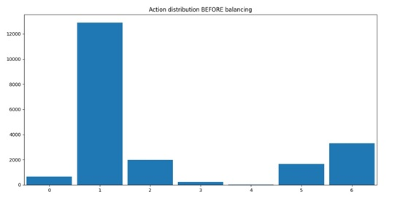
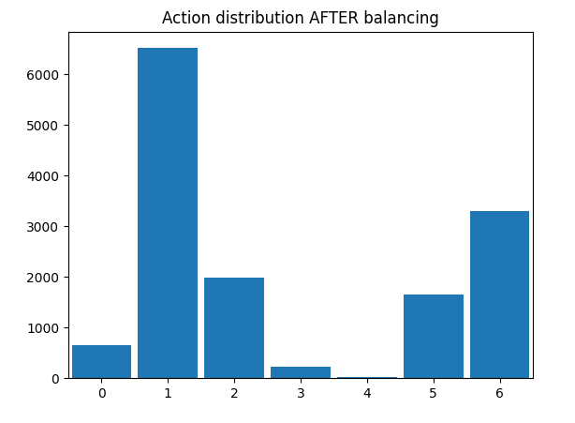
Environment and Simulation
Actions:
Drive straight
Accelerate
Turn right
Turn right braking
Brake
Turn left braking
Turn left
Action histogram diagram

Slide 11
Proposed Approach
This experiment works very well to train any game to use in the same above methods. Reinforcement learning approaches have recently achieved superhuman performance such as car racing which mimics the human experience.
Reward system: +1 when a car has moved in the right direction.
Goal: earn as much reward as possible by the end of the episode.
The episode finishes when all tiles are visited, or the car has gathered more negative rewards.
It has a camera image processing to make 2D simulation data.

Slide 12
Related Work
In robotic control applications, the ability to learn the dynamics of a system from observing only camera-based video inputs is a challenging but important problem. Early work on RL for active vision trained an FNN to take the current image frame of a video sequence to predict the next frame , and use this predictive model to train a fovea-shifting control network trying to find targets in a visual scene. To get around the difficulty of training a dynamical model to learn directly from high-dimensional pixel images, researchers explored using neural networks to first learn a compressed representation of the video frames. Recent work along these lines was able to train controllers using the bottleneck hidden layer of an autoencoder as low-dimensional feature vectors to control a pendulum from pixel inputs. Learning a model of the dynamics from a compressed latent space enable RL algorithms to be much more data-efficient.

Slide 13
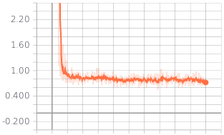
Possible Experiments
Accuracy
To get achieve high rewards, it is very important to have a good expert.
The neural network is totally unaware of rewards. In other words, in imitation learning the model is just trying to replicate the expert.
Validation accuracy is correlated with driving performance,
Training Loss

Slide 14
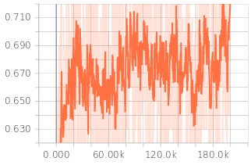
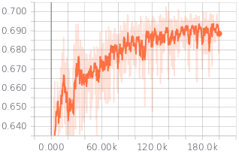
Possible Experiments
Training Accuracy
Validation Accuracy
The training accuracy quickly converged to 68% and noisily oscillated around that value throughout the training.
The validation accuracy was still steadily improving, finally converging around 69%.

Slide 15
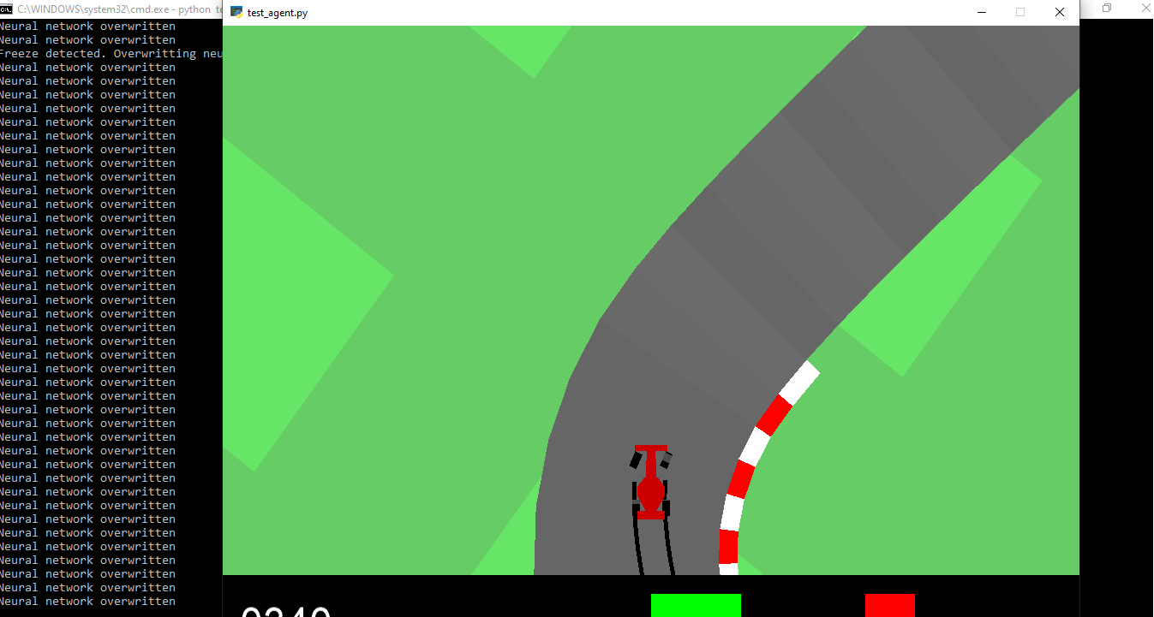
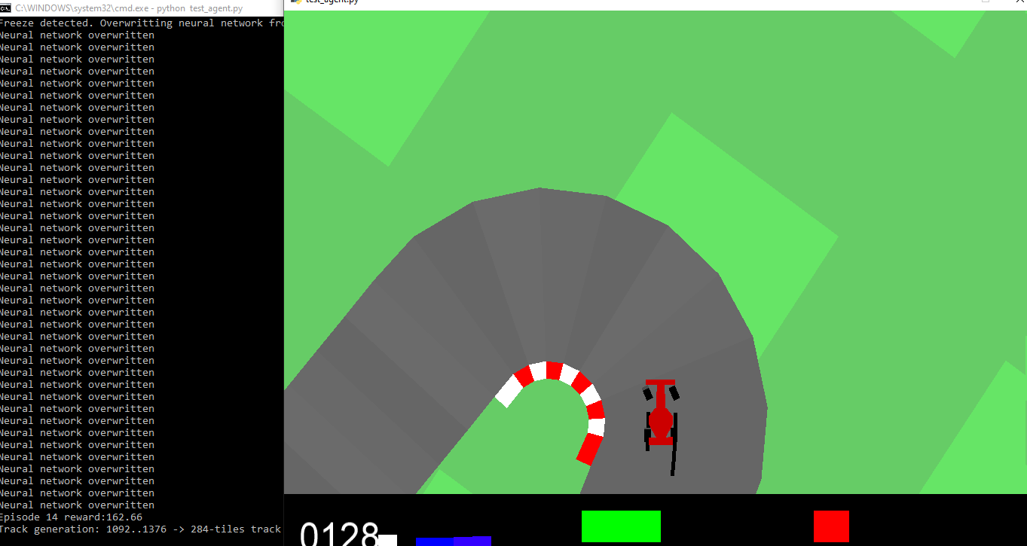
Some Initial Results

Slide 16
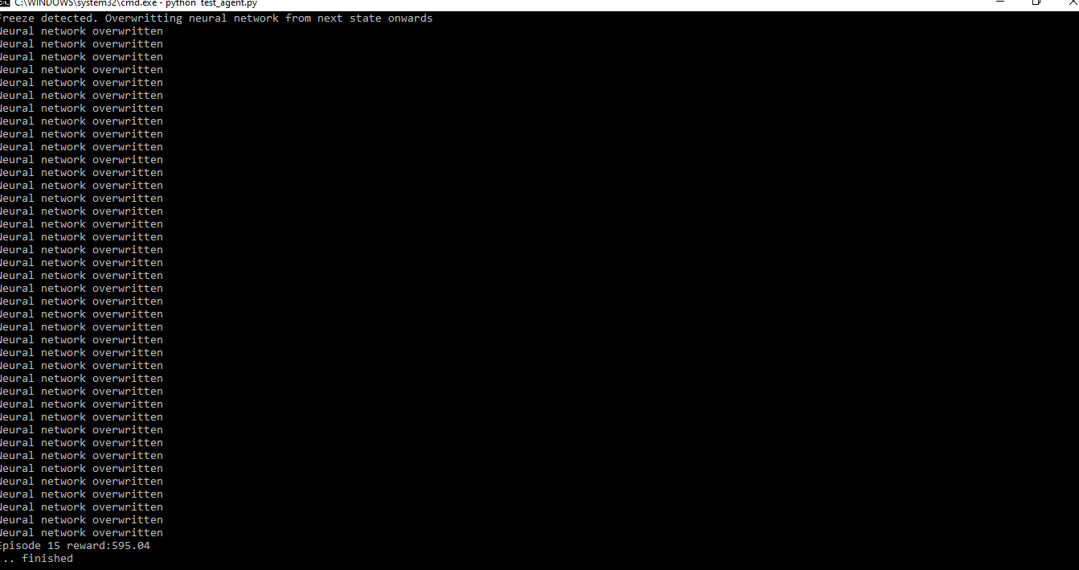
Some Initial Results

